Slide 1
On Learning, Representing and Generalizing a Task in a Humanoid Robot
Sylvain Calinon, Florent Guenter and Aude Billard
April 2007

Slide 2
Introduction
In this article it is proposed a Programming by Demonstration framework for generically extracting the main features off a given task while taking into acount the problems of generalizing the accquired knowledge to different contexts.
For the testing of this framework the data was collected from an humanoid robot, that was being taught through kinesthetics.

Slide 3
Objectives and Contributions
This framework was developed in order to address to the key questions of the Learning by imitation: what-to-imitate, How-to-imitate, when-to-imitate, who-to-imitate.
This method addresses this questions by making little or no assumptions, what make's it more generic.

Slide 4
Related Works/ Sate of art
[2] M. Skubic and R. Volz, “Acquiring robust, force-based assembly skills from human demonstration,” in IEEE Transactions on Robotics and Automation, vol. 16, no. 6, 2000, pp. 772–781.
[3] M. Yeasin and S. Chaudhuri, “Toward automatic robot programming: learning human skill from visual data,” IEEE Transactions on Systems, Man and Cybernetics, Part B, vol. 30, no. 1, pp. 180–185, 2000.
[5] A. Ijspeert, J. Nakanishi, and S. Schaal, “Learning attractor landscapes for learning motor primitives,” in Advances in Neural Information Processing Systems (NIPS), vol.15, 2002, pp. 1547–1554.
[6] A. Ude, C. Atkeson, and M. Riley, “Programming full-body movements for humanoid robots by observation,” Robotics and Autonomous Systems, vol. 47, no. 2-3, pp. 93–108, 2004.
[7] A. Shon, K. Grochow, and R. Rao, “Robotic imitation from human motion capture using gaussian processes,” in Proceedings of the IEEERAS International Conference on Humanoid Robots, 2005.

Slide 5
Related Works/ Sate of art
[8] S. Calinon and A. Billard, “Recognition and reproduction of gestures using a probabilistic framework combining PCA, ICA and HMM,” in Proceedings of the International Conference on Machine Learning (ICML), 2005.
[9] R. Zollner, M. Pardowitz, S. Knoop, and R. Dillmann, “Towards cogni-¨ tive robots: Building hierarchical task representations of manipulations from human demonstration,” in Proceedings of the IEEE International Conference on Robotics and Automation (ICRA), 2005.
[10] J. J. Steil, F. Rothling, R. Haschke, and H. Ritter, “Situated robot¨ learning for multi-modal instruction and imitation of grasping,” in
Robotics and Autonomous Systems, 2004, vol. 47, no. 2-3, pp. 129–141.
[11] A. Alissandrakis, C. Nehaniv, K. Dautenhahn, and J. Saunders, “An approach for programming robots by demonstration: Generalization across different initial congurations of manipulated objects,” in Proceedings of the IEEE International Symposium on Computational Intelligence inRobotics and Automation, 2005, pp. 61–66.

Slide 6
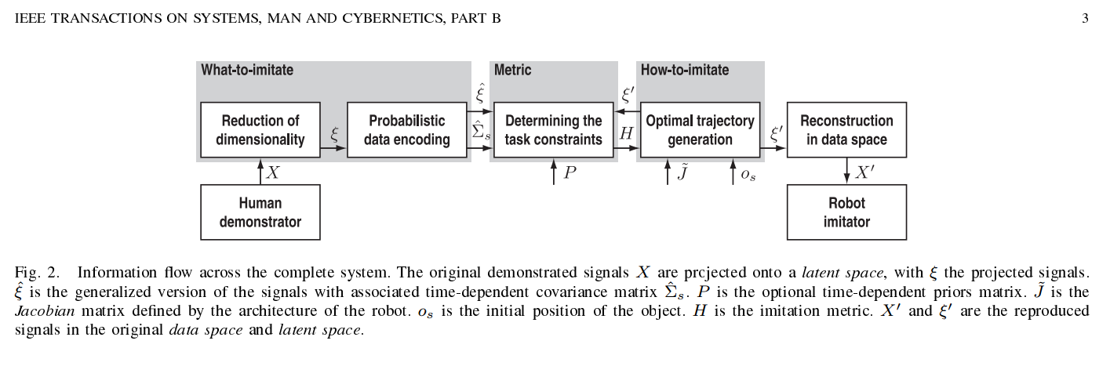
Proposed Work

Slide 7
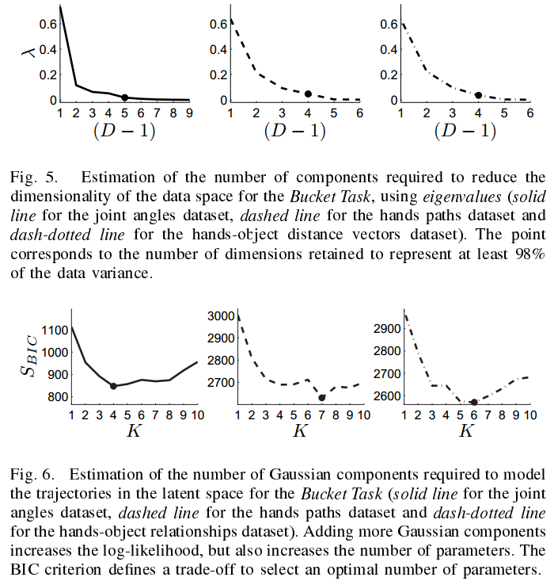
Results from the article

Slide 8
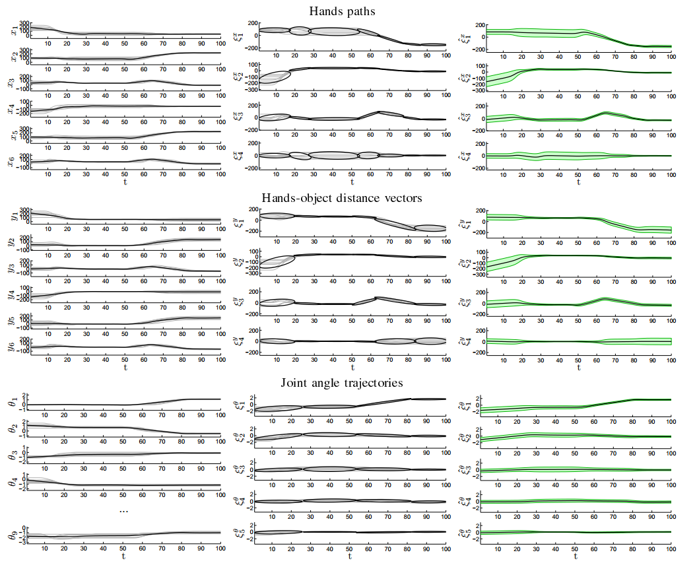

Slide 9
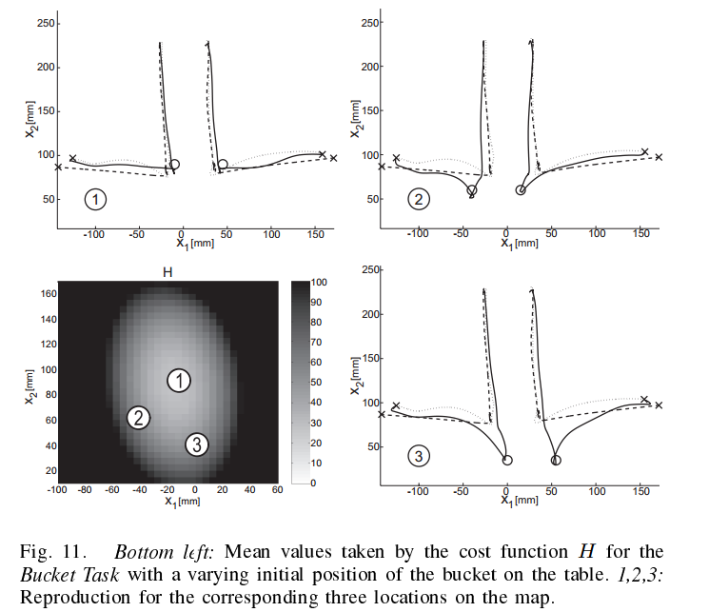

Slide 10
Conclusion
Extract the important features of a task;
Determine a generic metric to evaluate the robot's imitative performance;
Optimize the robot's reproduction of the task.

Slide 11
Critic opinion
Inovation:
They take both aproaches in their work:
- Different demonstrations of the same task are performed
- A probabilistically based estimation of relevance is used
to extract the important aspects of the task.
At the same time this is a more generic framework allowing the extraction of a time-dependent continuous representation of the constraints.

Slide 12
What could be improved?
“Actual humanoid robot sensorsmare still not able to capture subtle social cues in the way humans do.”
“In the experiments reported here, we implicitly assumed that
kinematics information was sufcient to describe the task and
that dynamics information was less important. This may not
always be true and certainly in some tasks the forces applied
to the object would be very important(...)”

